Slide 1

Simple Linear Regression

Slide 2
What is Linear Regression?
A method to predict one thing (like height) from another thing (like age).
It finds a line that best fits the data points.
Content:
Example: Predicting Height from Age
We have data on ages and heights of different kids.
We want to predict a kid's height based on their age.

Slide 3
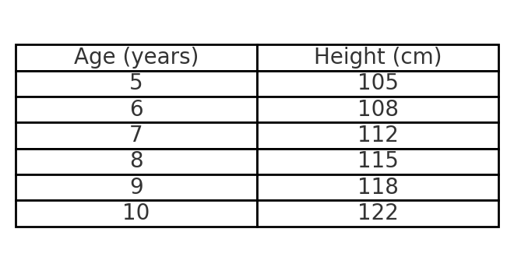
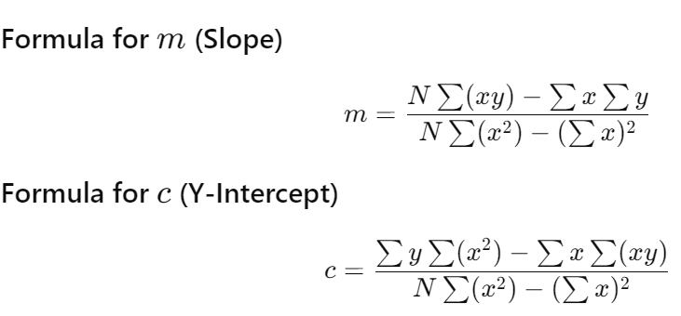
The formula for the simple linear regression line is: y=mx+c , where:
y is the predicted value (height).
x is the input value (age).
m is the slope of the line.
c is the y-intercept.

Slide 4
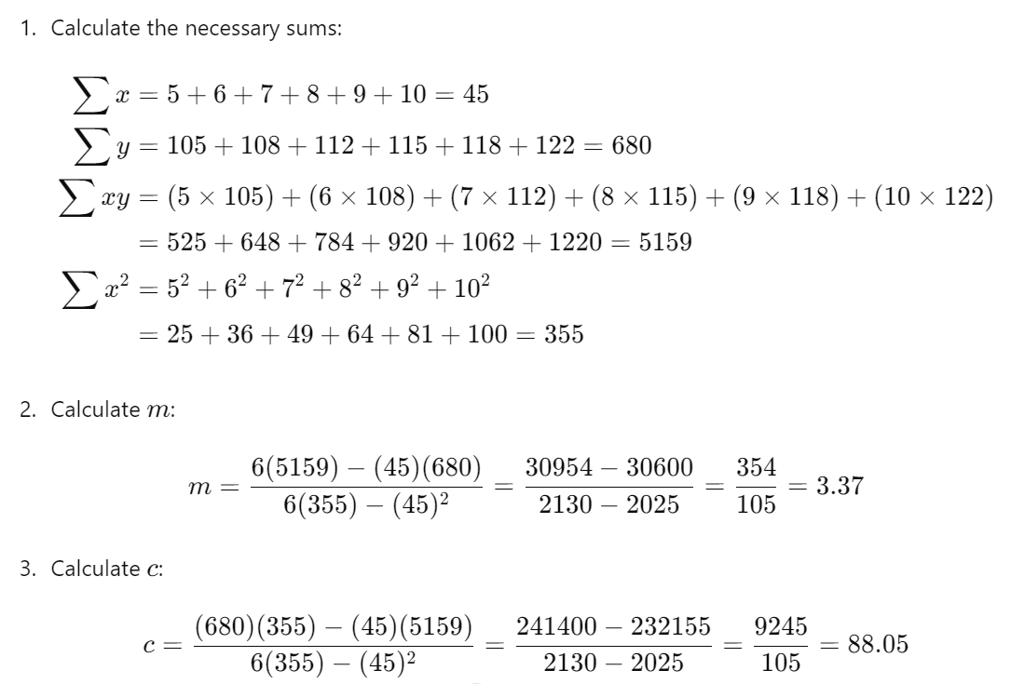

Slide 5
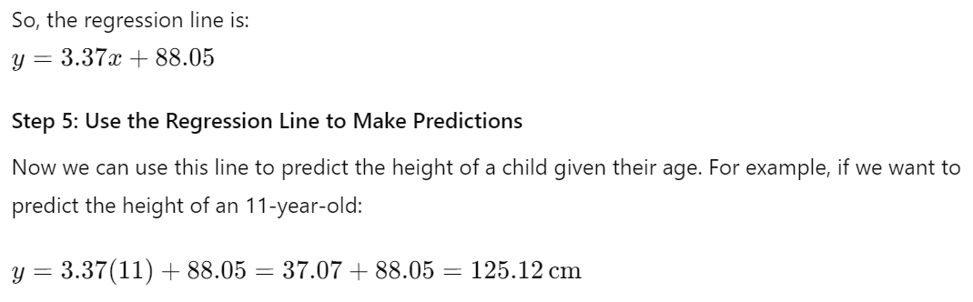

Slide 6
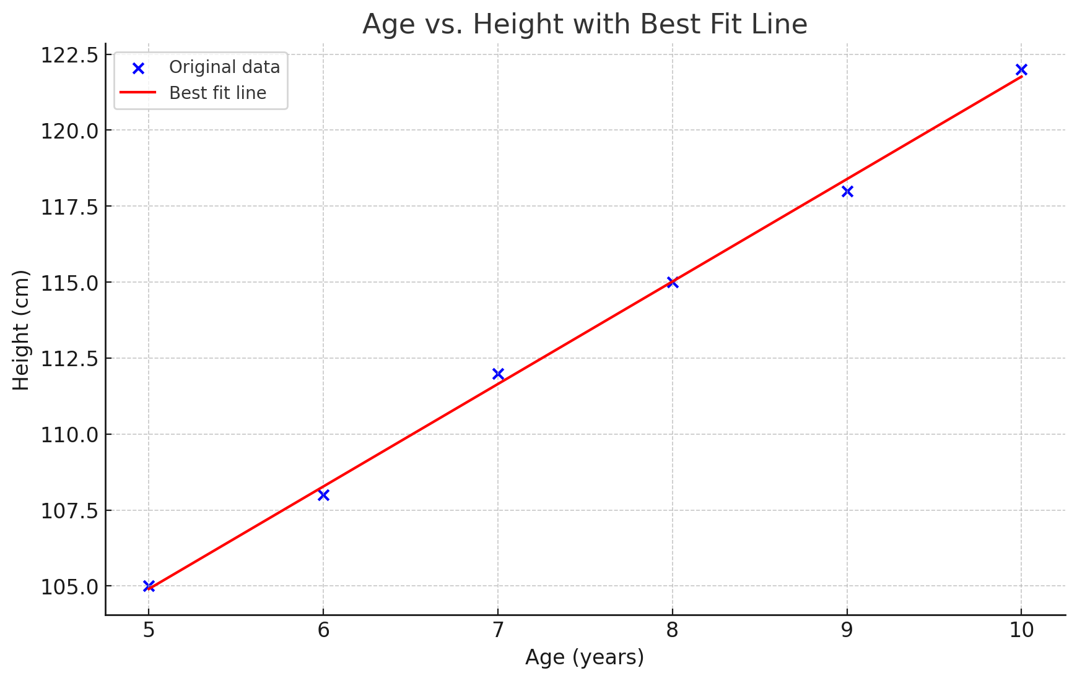

Slide 7
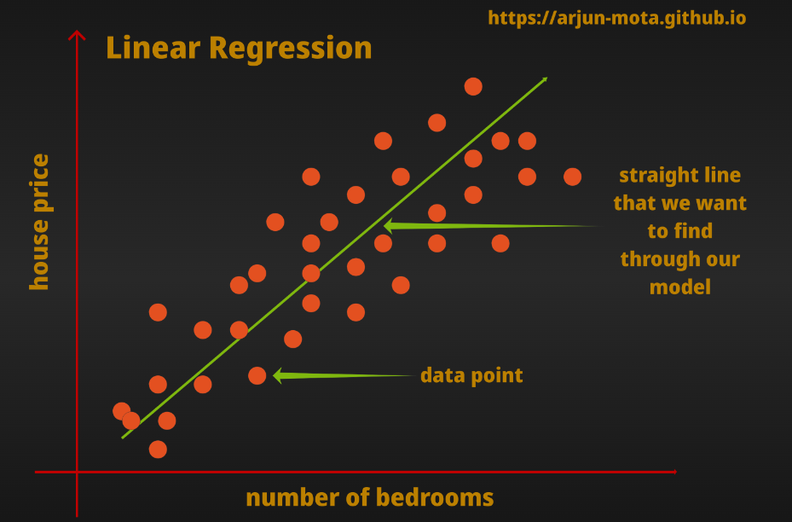

Slide 8
Multiple Linear Regression

Slide 9
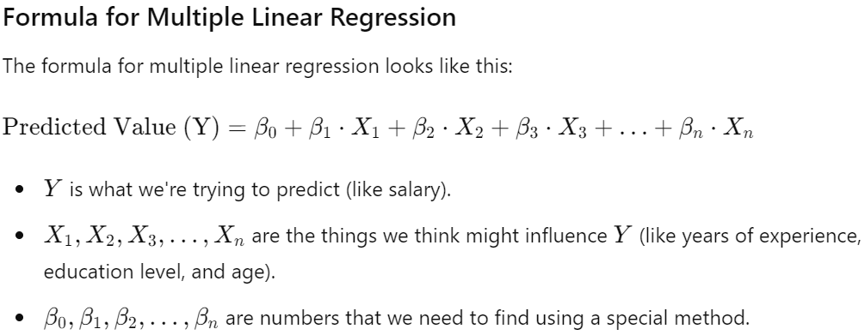
Multiple Linear Regression is a way to predict a value (like salary, temperature, etc.) based on more than one input (like years of experience, education level, and age).

Slide 10
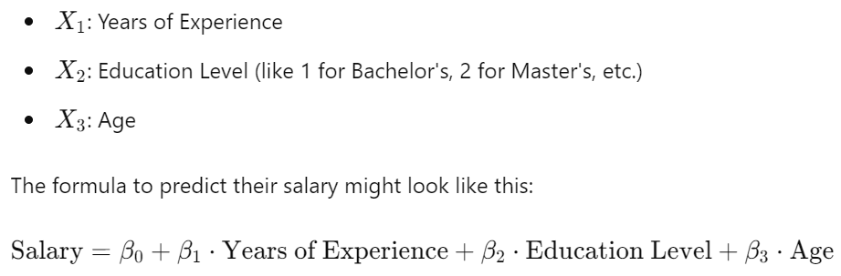
Multiple Linear Regression is a way to predict a value (like salary) using more than one piece of information (like years of experience, education level, and age). It helps us understand how different factors can affect the thing we're trying to predict.

Slide 11
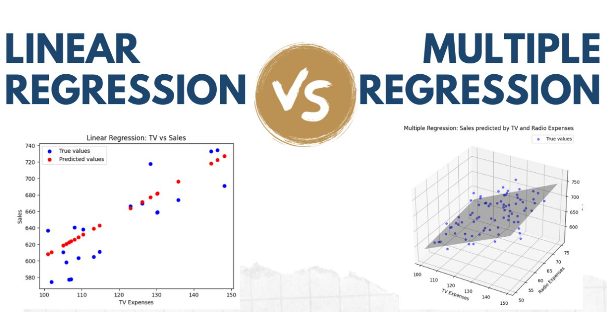

Slide 12



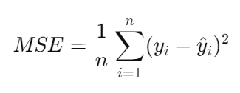
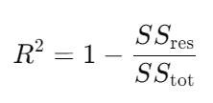

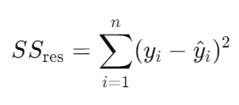
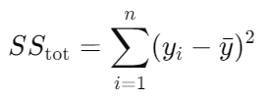
Mean Squared Error & R2 Score
Mean Squared Error (MSE) measures the average squared difference between predicted and actual values. R2 score represents the proportion of variance explained by the model.
MSE
Lower MSE indicates better
model fit.
R2
Higher R2 indicates
better model performance.

